Slide 1


Slide 2
DATA VISUALISATION
by : Hasnain Afridi
Qaleem Khattak

Slide 3
Contents:
What is Data Visualisation
Visualization in Everyday Life
Significance of Data visualisation
Different Representation (historical + present)
Tools & Softwares used in Data Visualisation
Advantages & Disadvantages

Slide 4
What is Data Visualization
Data visualization is the graphical representation of processed data.
Visualization is the use of computer graphics to create visual images which aid in the understanding of complex, often massive representations of data.
Intended to analyze complex data
For this purpose we use different types of tools & softwares like Rstudio, excel, tableau etc

Slide 5
What is Data Visualisation
The representation of data in the form of a chart, diagram, picture, etc
Data visualisation can also be used as a reporting tool
It involves producing images that communicate relationship among the represented data to viewers of the image.

Slide 6
Visualization in Everyday Life
a table in a newspaper, representing data being discussed in an article
a map of the region, to help select a route to a new destination
a graph of stock market activities that might indicate an upswing (or
downturn) in the economy;
Examples are google maps, Cricket FOW line graph

Slide 7
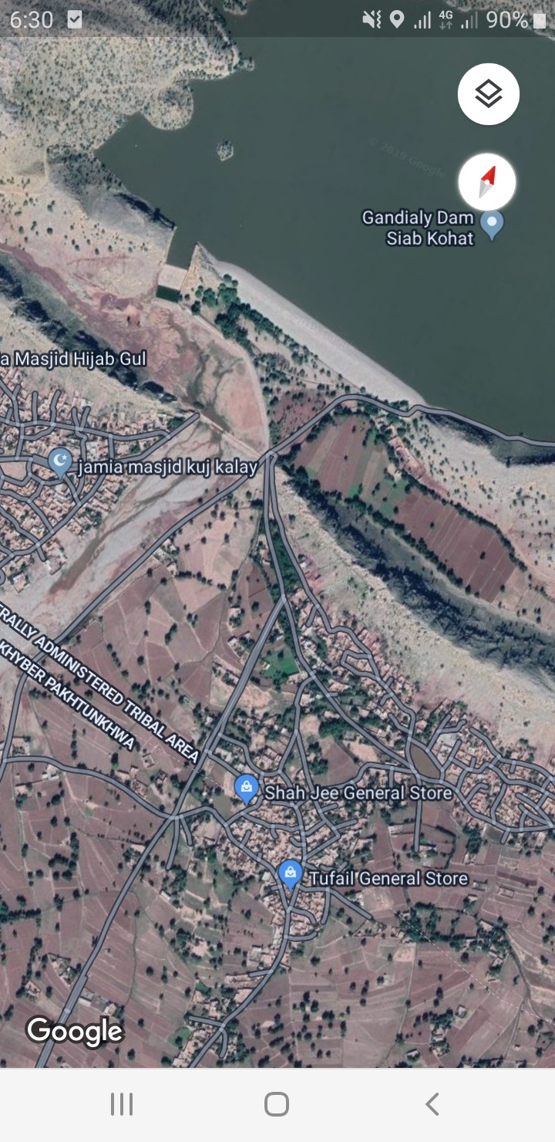
What is data visalisation

Slide 8
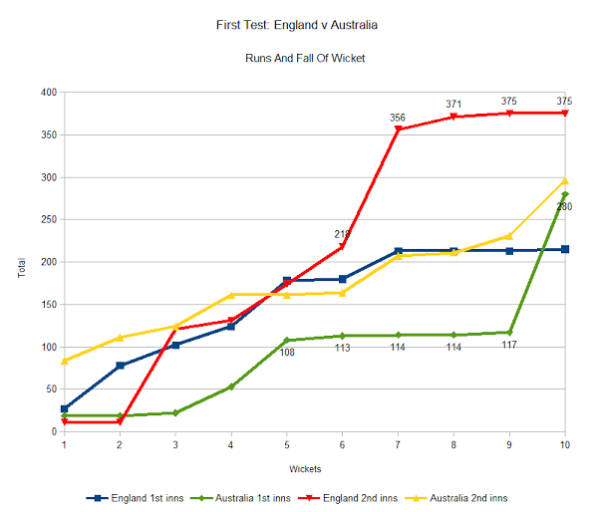
Fall of Wicket (Ashes test match)

Slide 9
Significance of Data Visualization
Human brains have a much harder time understanding complex data when it is encoded in numbers and text compared to graphics
The data visualization representation is easier to understand
Without data visualization techniques it is difficult to make & understand big data’s reports

Slide 10
Representation of Dviz.
The earliest and most obvious examples of dataviz projects are maps.
Nicole Oresme invented bar charts in the 14th century
The pie chart first showed up in the early 19th century.

Slide 11
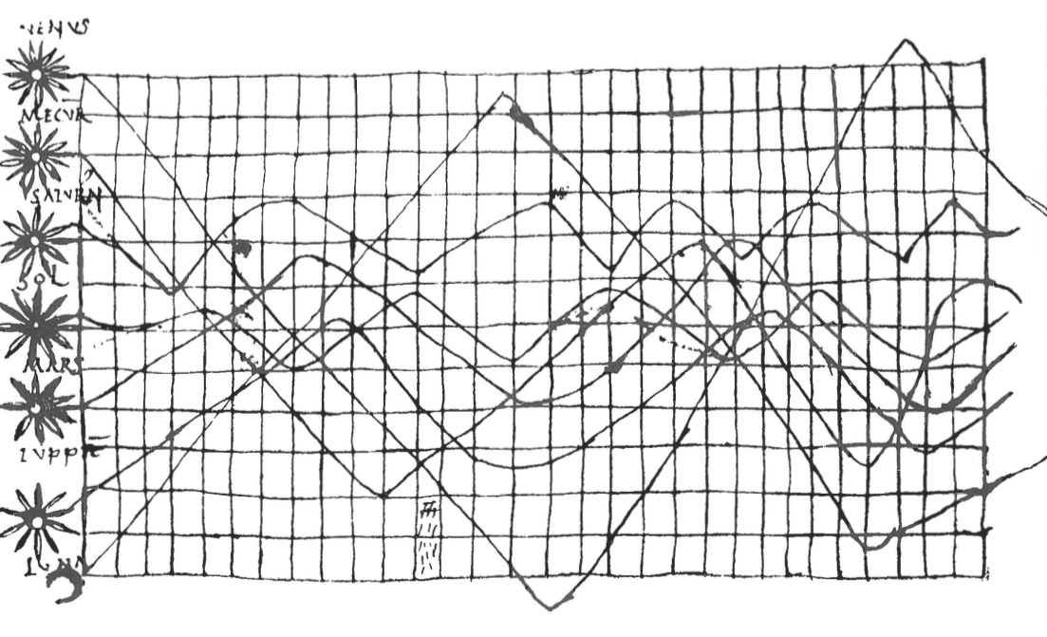
Data visualisation in 10th century

Slide 12
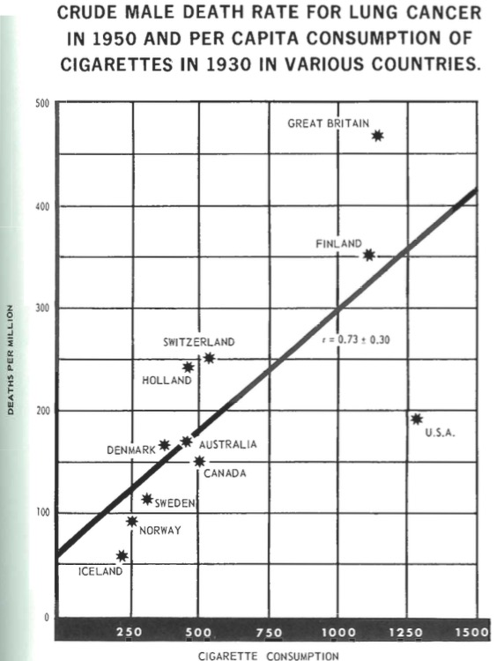

Slide 13
plot
A plot is a graphical technique for representing a data set using to show a relationship among two or more variables

Slide 14
Types of plots
Histogram
Scatter plot

Slide 15
Histogram
A rectangle shape diagram whose area is proportional to the frequency of a variable
It means it shows the frequency among variables

Slide 16
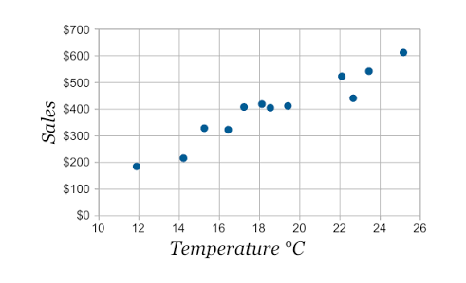
Scatterplot
A graph in which values of two variables are plotted along to axex.
The pattern of resulting points revealing any co-relation present.

Slide 17
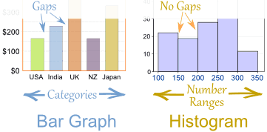
Bar graph
It is also called Bar-chart.
A bar graph is a diagram that uses bar to show comparison between categories of data.
The difference between Bar-graph and Histogram, Bar-graph show comparison between discrete variables while histogram shows comparison between continues variables.

Slide 18
Tools and Software
Tableau
R-Studio
Excel

Slide 19
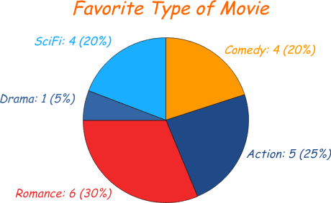
Pi-chart
A type of graph in which circle is divided into sectors that each represent of proportion of the whole.
It represent percentage among all variables.

Slide 20
Tableau
Tableau is a powerful and fastest and growing is data visualization tool used in business industries.
It helps in simplifying and updating raw data very easily.
The drag and drop function in this software are very helpful for data Scientist.
Data Scientists love tableau.

Slide 21
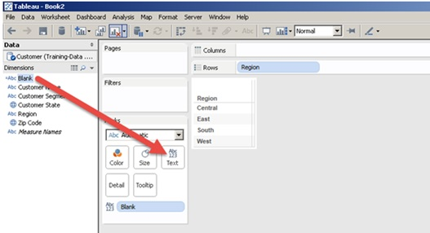
Tableau menu

Slide 22
R-studio
R-studio is an IDE for R language.
It is used for statistical computation graphs.
It also plotting raw data in very easy way.

Slide 23
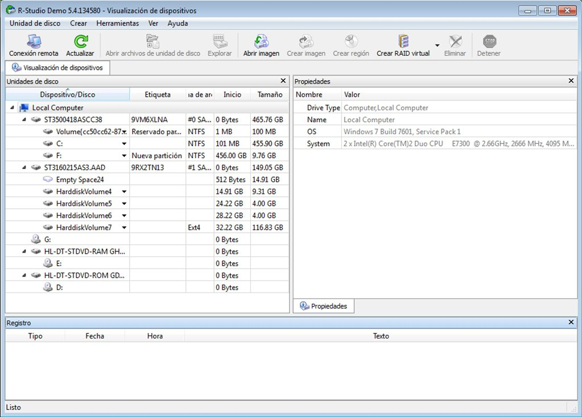
R studio menu

Slide 24
MS-Excel
It is product of Microsoft-Organization.
It is a software of spread sheet tables which used for different calculation about data.
It consists on rows and columns.

Slide 25
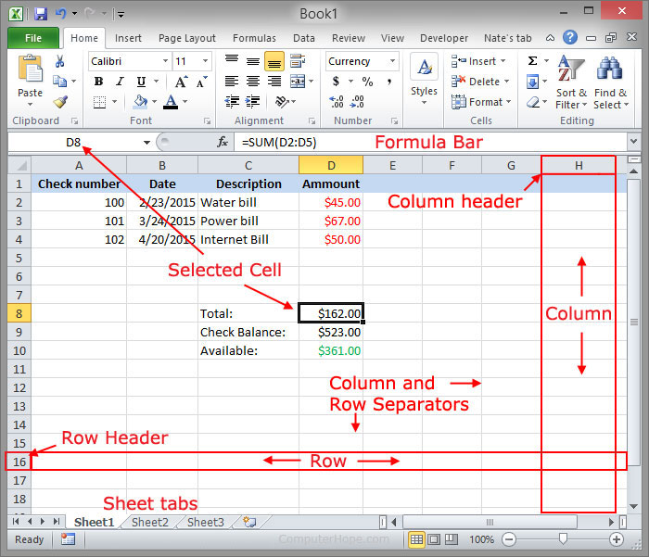
Ms excel menu

Slide 26
Advantages and disadvatages
ADVAVTAGES
Faster action
Understand connection b/w operations and results.
Decision makers often rely on Dviz, it is very helpful in decision making.

Slide 27
Disadvatages
It require highly technical person.
Heavy software require

